Slide 1
**The Data:
The data set is a set of 18 features: 10 numerical and 8 categorical. This dataset has 12330 entries, split into 10,422 entries where the shoppers did not purchase and 1908 entries where the shoppers did purchase. Each entry is based on unique users in a 1-year period to avoid any trends specific to a specific campaign.
Classifying Online Shopper’s Intention

Slide 2
Problem Statement
This is the data of an online retailing company where they are trying to find which online shopper will generate revenue by his/her online shoppers’ activity on their site.

Slide 3
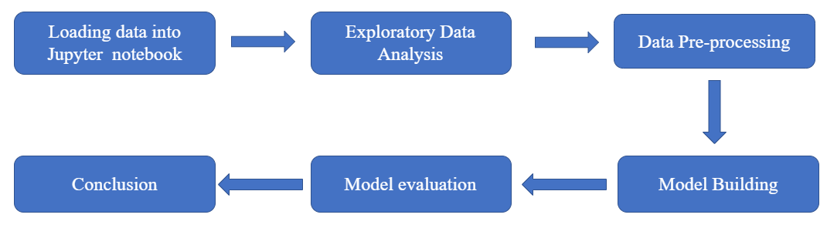
Work flow

Slide 4
OBJECTIVE
Gaining insights about how and when shoppers will research and purchase goods online as it is important to business as they can use customer behavior insights to target advertising, marketing, and deals to potential customers to further increase their sales and revenue.
Proposed Methods:
Logistic Regression
Decision Tree
Random Forest
Support Vector Machine
Naïve Bayes
KNN

Slide 5
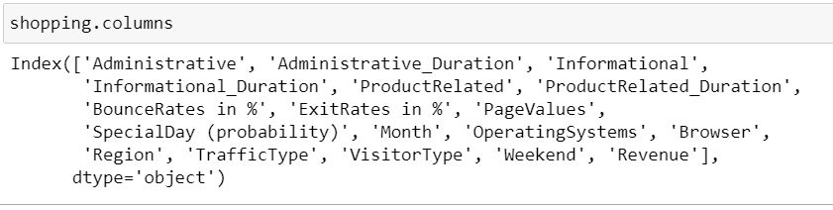
Dataset

Slide 6
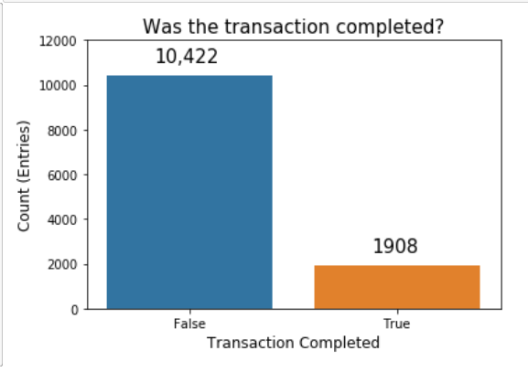
Exploratory Data Analysis
Identified that there are no null values in the dataset.
From the chart we can understand that number of entries where the customer ended up not purchasing is much higher that the number of entries where the customer ended up completing a transaction. This makes sense, as most normal online shopping ends without a purchase.

Slide 7
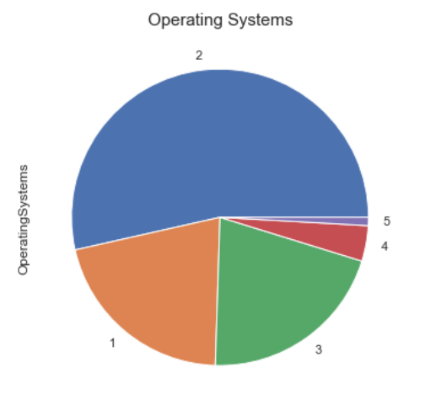
Here we have the Operating Systems, labeled by number. Low-usage browsers have been consolidated into label '5'. We can see that most of users use operating system #2. Operating systems can indicate users of a specific type of computer and may portray certain user archetypes (Windows users, Mac users, Linux users). For now, we will forgo usage of this column for our classifier.

Slide 8
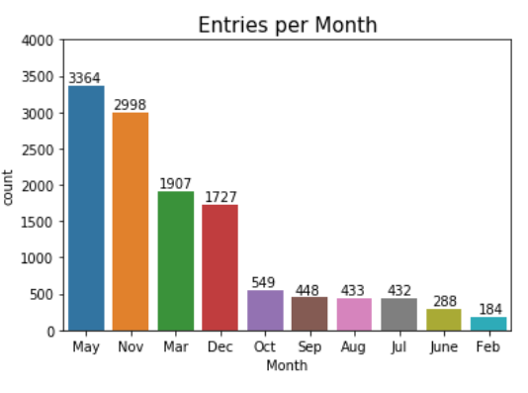
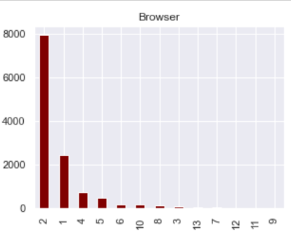
We can see here that the 'Month' column is missing for January and April. We can see visually that several months have many samples (May, Nov) and a couple have very few samples (Feb, June).
Browser choice is even more polarizing than Operating System. Here we see that a large majority of users use browser 2, with a smaller number of users using browser 1. All other browsers represent a small subsection of online users. We will not use this as it does not contribute much to our model.

Slide 9
'Traffic Type': We leave this column out because Traffic sources are not quite useful for classifying if a user will make a purchase. It usually aids website owners in gauging traffic sources and can assist with determining where they should invest in advertisement.
'Weekend': There is weak correlation between days of the week and online shopping.
Label and One Hot Encoding:
In order to properly fit our classifier, we will need to encode our string variables to integer labels, then convert our labels from integers to One Hot columns .

Slide 10
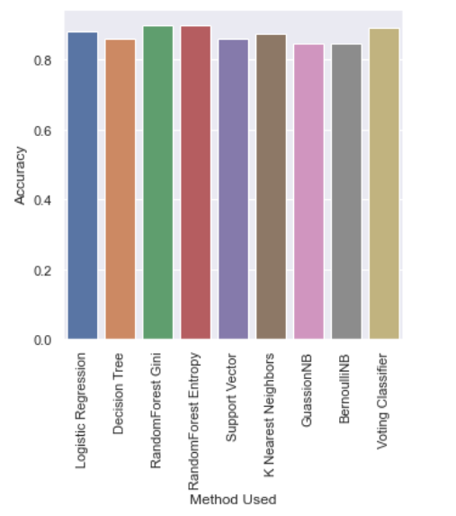
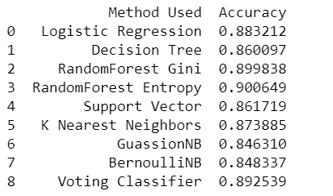
Model Building
Approach 1(With out balancing the class)
Have applied below mentioned ML models for the data set, the results are as follows:

Slide 11
Approach 2(balancing the revenue class)
Stratifying Training Data
Because the training data is so heavily skewed in the direction of the 'No purchase made' category, we must stratify our training data so that the ratio of training labels is equal. We use the stratified shuffle split package included in the Sci-kit learn library to achieve this.

Slide 12
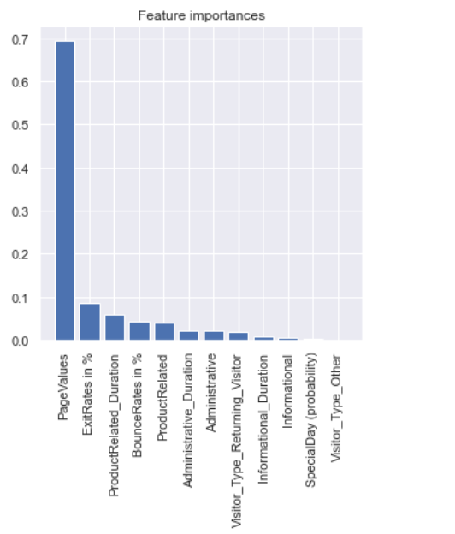
Approach 3
Feature Importance
To see if we can improve our model,
let us track the feature importance of
each of our features to see
features matter to the outcome of
the prediction.

Slide 13
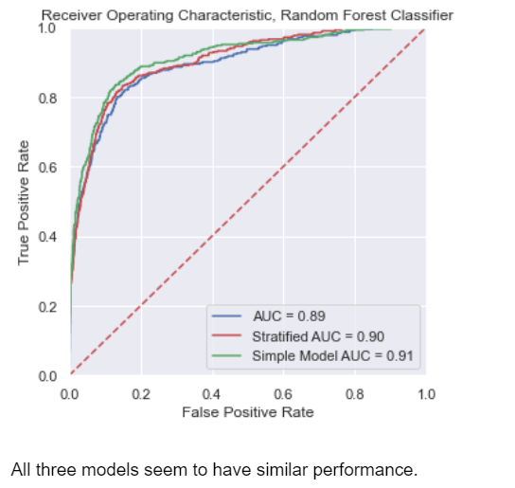

Slide 14
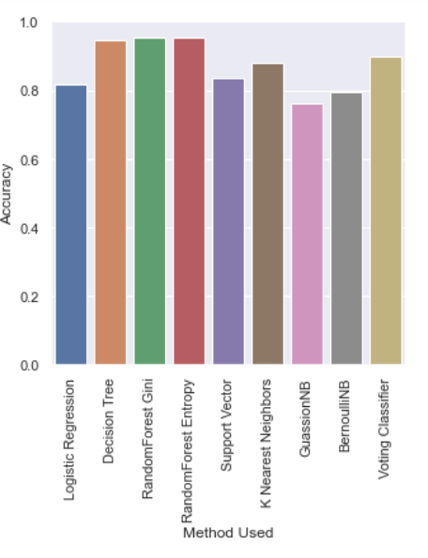
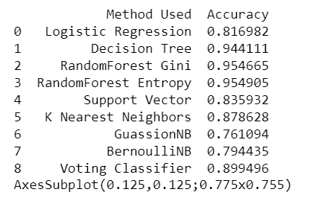
Approach-4
Since we have imbalanced dataset , have used random over sampler method to balance the imbalance class.
Applied ML models to the transformed dataset and the results seems be more accurate .

Slide 15
Conclusion
By using a random forest classifier, we are able to achieve approximately 94% accuracy. If we were to deploy this model, the most efficient model to select would be our simple model. The simple model performs similarly to our other models, and only bases its classification by five features.

Slide 16
THANK YOU

